Slide 1

Barneys Reef Wind Farm
Community Consultative Committee meeting, April 2022

Slide 2
Agenda
Project Refinements
Project Timeline Update
EIS Assessment Results
February Info Session Results
Ongoing Consultation
Q & A

Slide 3
GENERAL UPDATE
Project Refinements/Progress
Removal of landowners in the north-west of project
New access points from Castlereagh Highway and Merotherie Rd
Adjustment of turbines considering Cultural Heritage results
Tracks refined and moved based on consultation with landowners
Option to Lease agreements are nearly signed with most landowners
Two additional LiDARs deployed
Further Ecology surveys
LVIA, Noise, Aviation and Route Assessments early results available
Three community information sessions held
Completion of neighbour consultation period for SIA

Slide 4
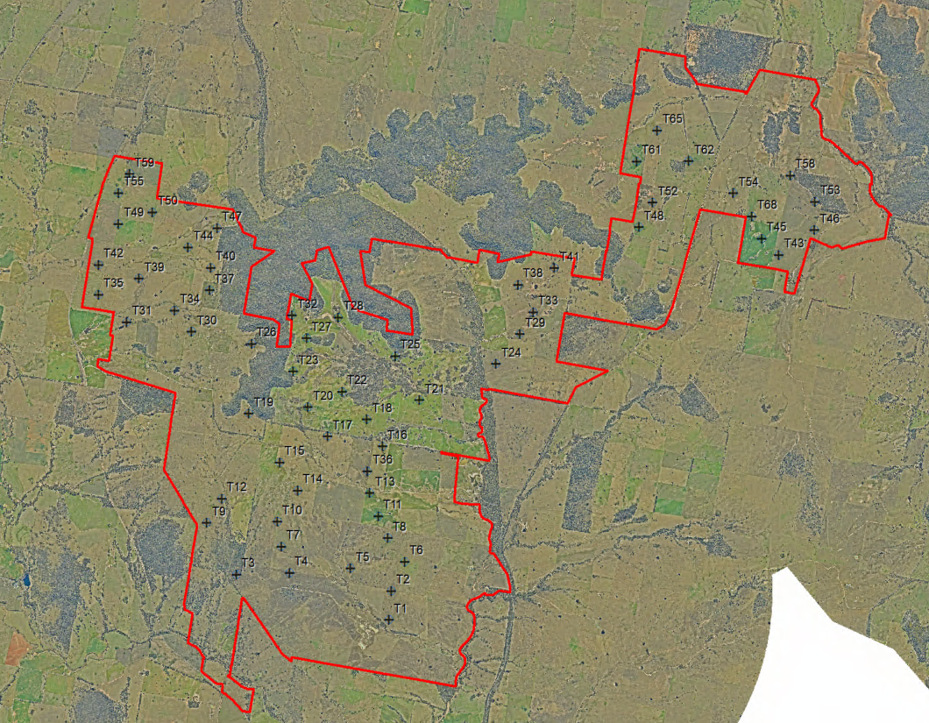
GENERAL UPDATE
Layout Revision
Currently 60 turbines (circa 420 MW)
Substation in the middle of the project
BESS up to 700MWh (100MW, 7hr duration)
Further refinements possible from additional consultation and detailed design
Next steps: finalise track layout, internal layout approval meeting

Slide 5
GENERAL UPDATE
Project Timeline
DA Submission has been delayed due to weather and changes to the layout
Expected submission is June 2022
Construction and operations timing to be in line with energisation of the EnergyCo transmission infrastructure

Slide 6
EIS UPDATE
Archaeology Results
Field survey complete
Some areas of significance found
These have been avoided in the latest revision of the layout (two turbines moved approx. 50m to ensure no impact)
Next steps:
  Finish ACHAR report
  Further study required after planning submission to develop CHMP

Slide 7
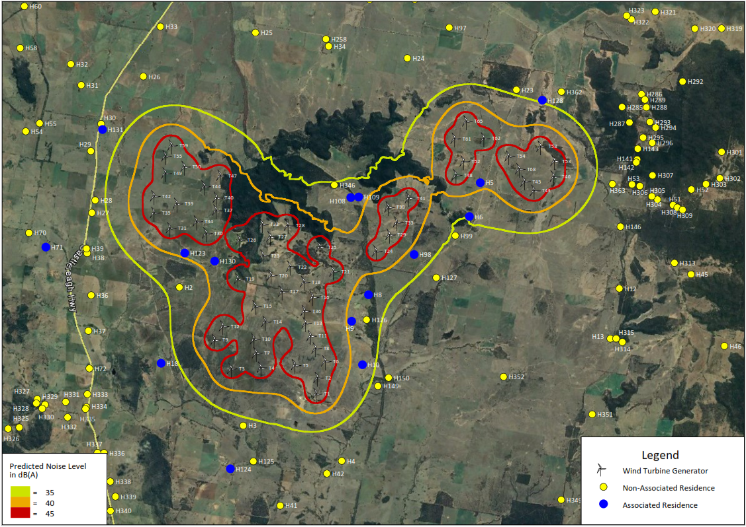
EIS UPDATE
Noise Assessment
Six weeks of noise monitoring complete
Noise contour has been run on current layout
3 uninvolved houses currently within 35dB(A) contour (doesn’t take background noise into account)
  Expectation that vegetation surrounding houses will reduce impact from turbines
Serrated blades will be used to reduce noise impact
Next steps:
  Re-run noise contour considering background noise levels
  Discuss ways of mitigation/active management of impacts
  Finish report

Slide 8
EIS UPDATE
Route Assessment
Route assessment has been undertaken, with the following findings:
  Blades will fit completely within the road reserve most of the way to site
  Some additional landowners may be needed along Merotherie Rd (depends on blade length)
  May be a need to use local roads through Muswellbrook council if turbine components cannot fit under the Denman Bridge (height limit of 5.6m)
Discussions with Mid-Western Council and Warrumbungle Council for road upgrades (especially to Merotherie Rd)
Next steps:
  Discussion with Muswellbrook council to discuss local road use
  Discussions with potentially impacted landowners

Slide 9
EIS UPDATE
Aviation Assessment
All turbines outside of Mudgee airport extent
Closest Aircraft Landing Areas:
  Gulgong Aeropark
  Merotherie Crossing
No impact to Gulgong Aeropark due to distance from turbines and direction of runway
Merotherie Crossing ALA may have some downstream wake turbulence effects on the downwind leg of the southern circuit, only during southerly wind conditions.
Next steps:
  Consultation with Gulgong Aeropark and Merotherie Crossing ALA to discuss findings
  Consultation with other stakeholders

Slide 10
EIS UPDATE
LVIA Assessment
Field work complete
Four photomontages have been produced
15 houses identified as having a higher visual impact, of these:
  At least 2 are host landowners
  At least 1 doesn’t permanently live at the property (e.g. holiday houses)
Currently working through contacting each landowner of properties assessed as high impact and discussing mitigation options
Next steps:
  Produce additional photomontages (one for each high impact location)
  Finish discussions with most impacted landowners
  Produce final report

Slide 11
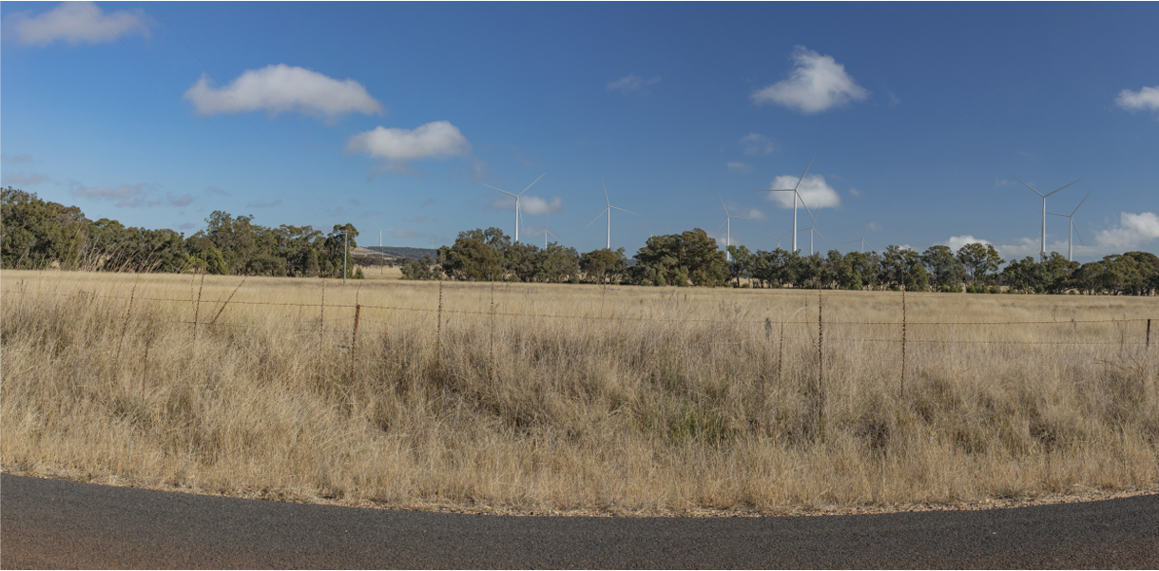
VISUAL MONTAGE - BARNEYS REEF WIND FARM
Blue Springs Rd, Bungaba
Looking West
2.3km to nearest turbine

Slide 12
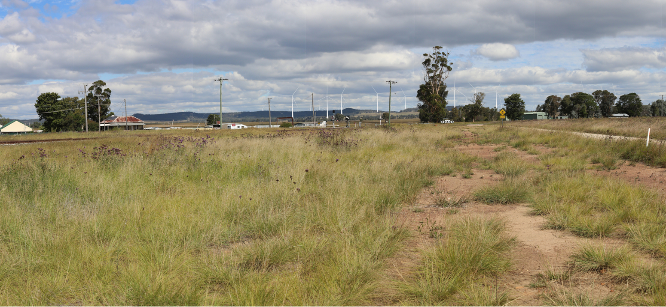
VISUAL MONTAGE - BARNEYS REEF WIND FARM
Birriwa Rd, Birriwa
Looking East
4.5km to nearest turbine

Slide 13
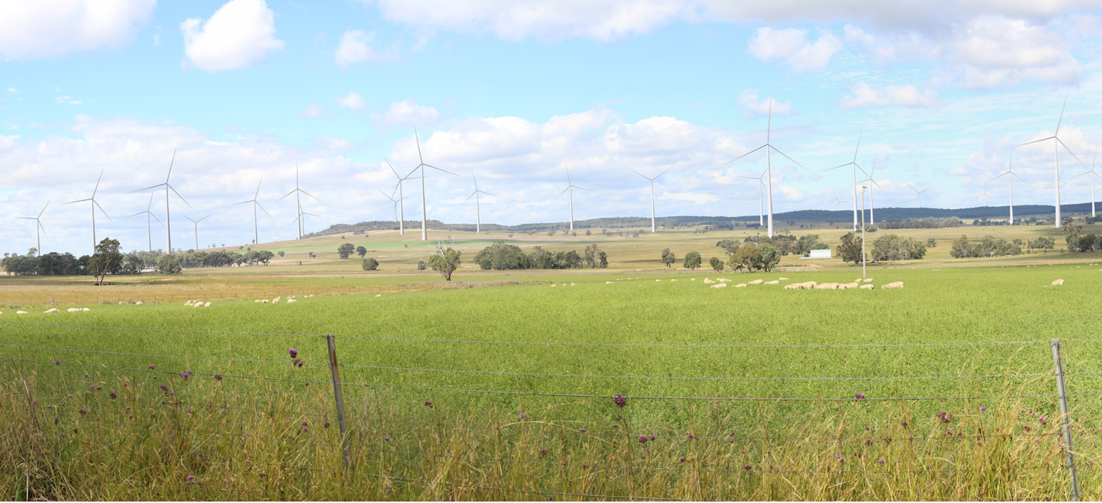
VISUAL MONTAGE - BARNEYS REEF WIND FARM
Castlereagh Hwy, Tallawang
Looking East
2.1km to nearest turbine

Slide 14
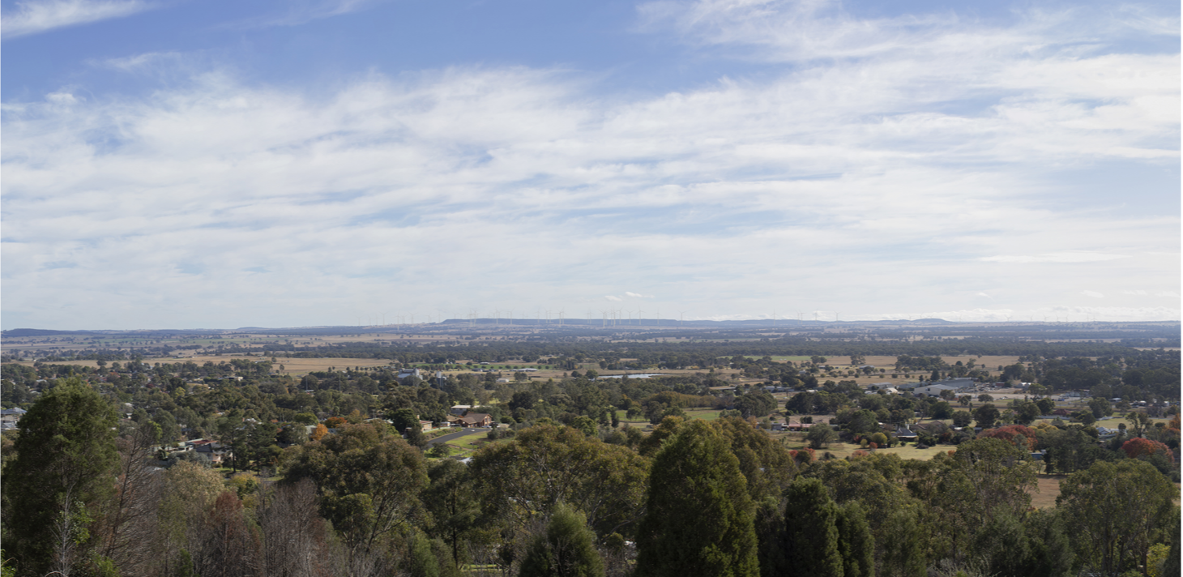
VISUAL MONTAGE - BARNEYS REEF WIND FARM
Flirtation Hill, Gulgong
Looking North
13.6km to nearest turbine

Slide 15
COMMUNITY INFORMATION SESSIONS OUTCOMES
Dunedoo Show, February 12
Feedback from 54 community members
Concern around cumulative impact from multiple projects most common concern (14)
Questions more focussed on REZ, rather than RES projects
Gulgong Show, February 19
Feedback from 73 community members
Most common concerns - visual impact (13) land use (4) cumulative impact (4)
Online, February 23
Nine attendees (4 broader community members, 5 project neighbours)
Concerns raised - cumulative impact, adequacy of assessments, visual impact

Slide 16
DEVELOPMENT
Ongoing Consultation
Further engagement planned to provide information on assessment outcomes:
  Assessment summaries delivered to +100 mail list
  One-on-one meetings with impacted community members to interpret outcomes
Attendance at future community events for the REZ
Ongoing engagement through the CCC
Discussions continuing with key stakeholders regarding community fund arrangements and development of Neighbour Shared Benefit Program

Slide 17

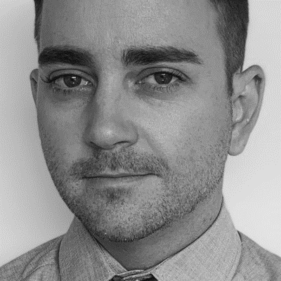



Get in touch
165 Walker Street
North Sydney
NSW 2060
Darren Chesterfield
Community Engagement Manager
+61 487 203 829
darren.chesterfield@res-group.com
Eleanor Cairns
Development Project Manager
+61 434 368 215
eleanor.cairns@res-group.com

