Slide 1
Barneys Reef Wind Farm
Community Consultative Committee meeting, July 2022

Slide 2
Agenda
Project Update
Project Progress
Layout
Project Timeline
Community Consultation
Ongoing Activities
Sponsorships
Tallawang Solar Farm Update
Q & A

Slide 3
GENERAL UPDATE
Project Progress
Half of Option to Lease agreements signed, other half are nearing completion
Layout undergoing last optimisation before finalising for remaining EIS studies and DA submission
Discussions with swept paths landowners underway
LiDARs deployed next to met mast three months ago have completed validation and can be moved to other parts of the site for further monitoring

Slide 4
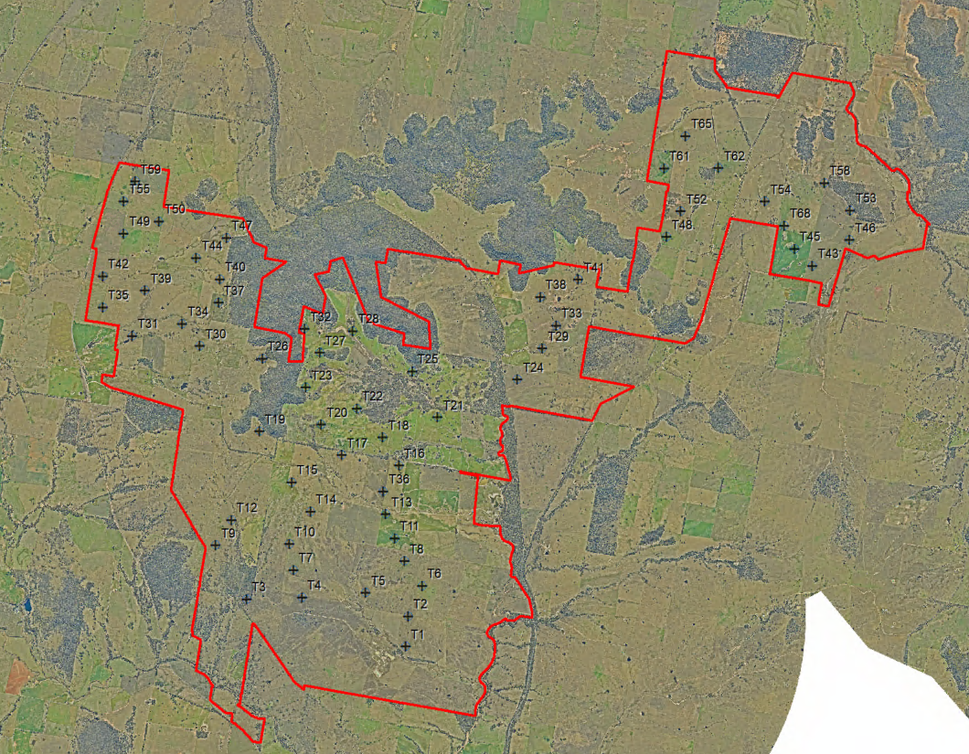
GENERAL UPDATE
Layout
Layout remains as it was at the last meeting
Currently 60 turbines (circa 420 MW)
Substation in the middle of the project
BESS up to 700MWh (100MW, 7hr duration)
Layout is currently undergoing optimisation, to be complete mid-July
Confirmed layout to submit with the DA likely at end of July (including tracks, hardstands,
Expecting a similar number of turbines and impact area

Slide 5
GENERAL UPDATE
Project Timeline
DA Submission is further delayed due to changing requirements from DPE
Arch test pitting pre-submission likely to put a 4-6 month delay on planning submission
DA submission is now likely at the end of this year

Slide 6
Community Consultation
Ongoing Activities
Further engagement planned to provide information on assessment outcomes:
Assessment summaries delivered to +100 mail list
One-on-one meetings with impacted community members to interpret outcomes
Likely attendance at future community events for the REZ
Ongoing engagement through the CCC
Evaluation of community feedback about project benefit sharing and engagement with projects neighbours about the Neighbour Shared Benefit Scheme (SBS)

Slide 7
Community Consultation
2022 Sponsorships
Community Bus - funding for 6 months
Mudgee Rotary - partial funding for Louisa Lawson Statue
Gulgong Gossip - 'Kids Corner' sponsorship for 6 months
Art Unlimited – Photo Prize sponsor
Run for Resilience – Dunedoo race sponsor
Gulgong and Dunedoo Shows – show sponsor
Mudgee LALC – committed funds to property development**
Christmas Lights????
2023 Sponsorships
Red Hill EEC – Eco Schools annual sponsorship
Further ideas welcome!

Slide 8
DEVELOPMENT
Tallawang Solar Farm Update
DA submitted for adequacy in May 2022
Additional requirements came back from DPE which are currently being worked through
Expected formal submission mid-July 2022
Exhibition will commence after lodgment, for 28 days

Slide 9
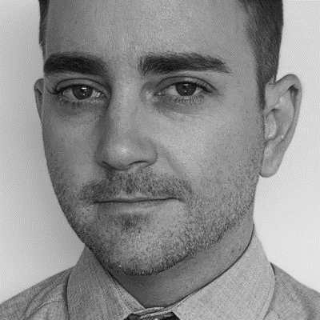
Get in touch
165 Walker Street
North Sydney
NSW 2060
Darren Chesterfield
Community Engagement Manager
+61 487 203 829
darren.chesterfield@res-group.com
Eleanor Cairns
Development Project Manager
+61 434 368 215
eleanor.cairns@res-group.com

