Slide 1

Barneys Reef Wind Farm
Community Consultative Committee meeting, October 2022

Slide 2
Agenda
Project Update
Community
Tallawang Solar Farm Update
Q & A

Slide 3
PROJECT UPDATE
Project Progress
Layout has been optimised based on collected wind data, completed EIS studies so far and consultation with the community
Project now has 69 turbines (more detail on the next slide)
Option to Lease negotiations are ongoing, only two documents remain
EIS studies have been kicked off again with the updated layout
Next major piece of work is archaeological test pitting, due to begin on 24/10 and run for approx. 5 weeks (dependent on ground conditions and number of findings)
LVIA assessment has been re-run with increased number of turbines, there is no additional impact from the increase in turbine numbers

Slide 4
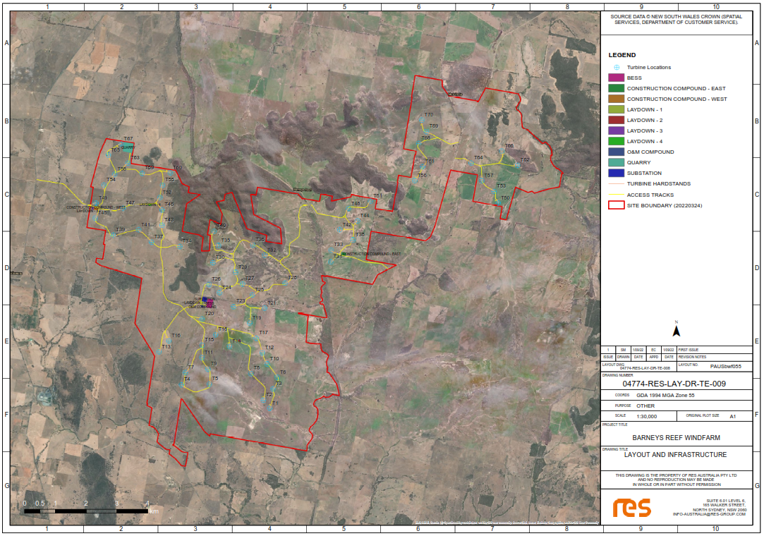
PROJECT UPDATE
Layout update
Layout has been updated based on wind data, ecological and archaeology data
Increased to 69 turbines
Substation in the middle of the project
Proposed BESS up to 700MWh (100MW, 7hr duration)

Slide 5
ASSESSMENT UPDATE
LVIA Assessment
LVIA assessment has been re-run based on updated layout
Tool shows no additional impact as a result of studies
Following two slides show comparison of ZVI between 2021 and 2022 layouts
Number of houses of moderate and high visual impact within 3.75km:
  Moderate: 9
  High: 5
Discussions with these neighbours are underway to determine their opinion on the level of impact and discuss mitigation options

Slide 6
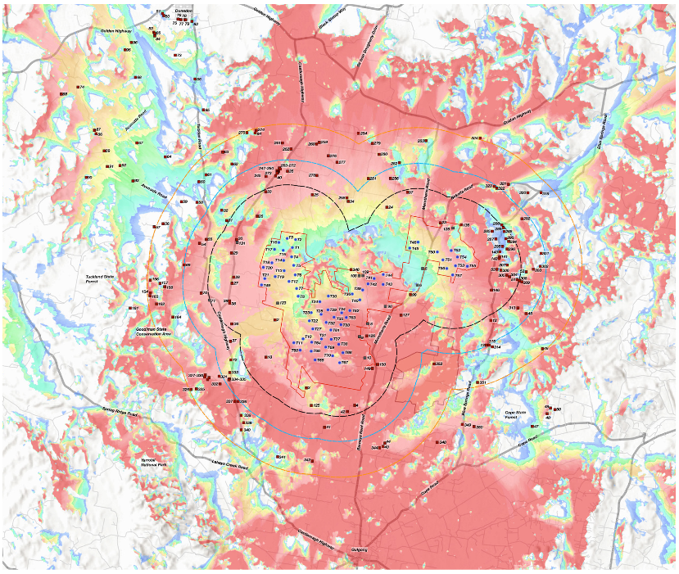
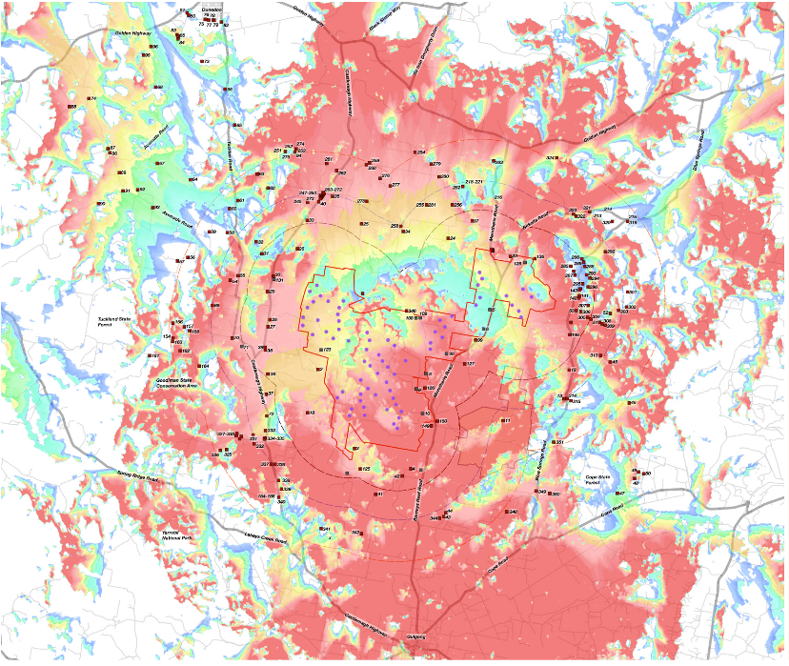
COMPARISON OF ZVI TOOLS
2021 Layout
2022 Layout

Slide 7
PROJECT UPDATE
Project Timeline
DA submission expected early in 2023.
No change expected to the timing of construction for the project, this will still be aligned with the energisation of the CWO REZ
Construction expected to begin Q3 2024

Slide 8
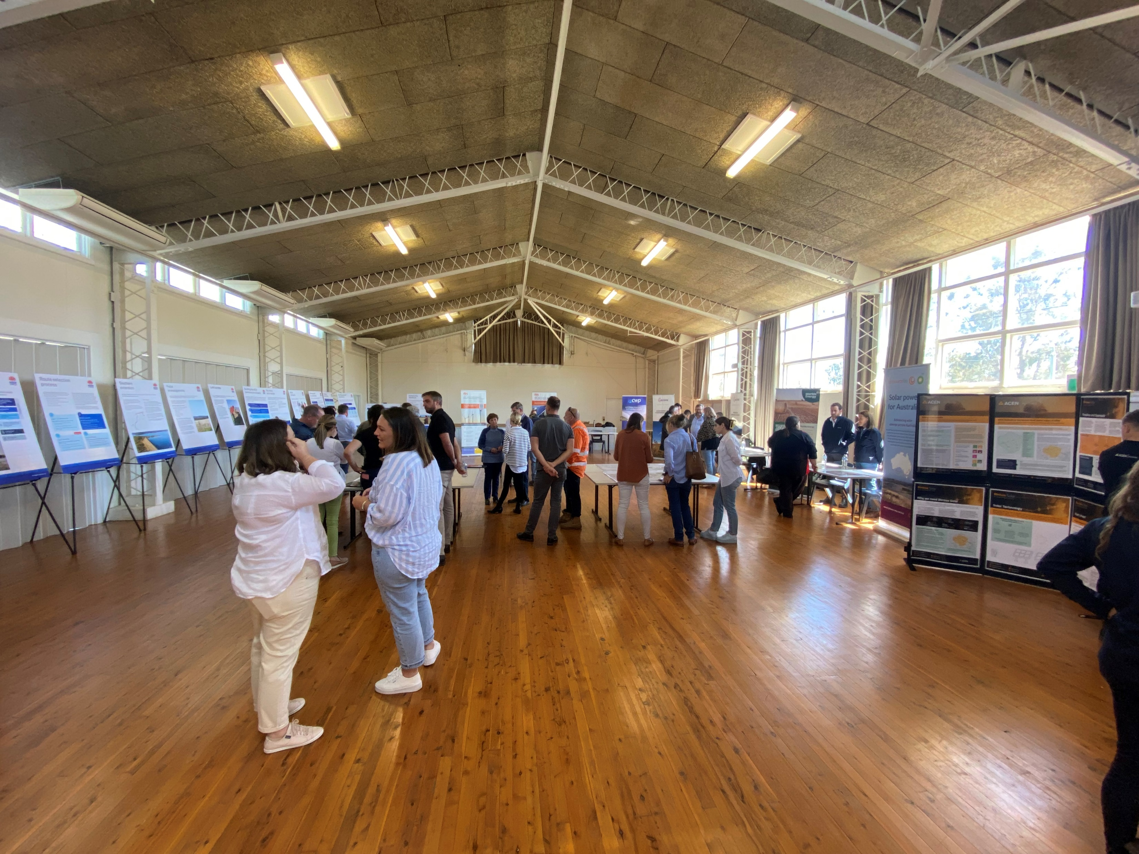
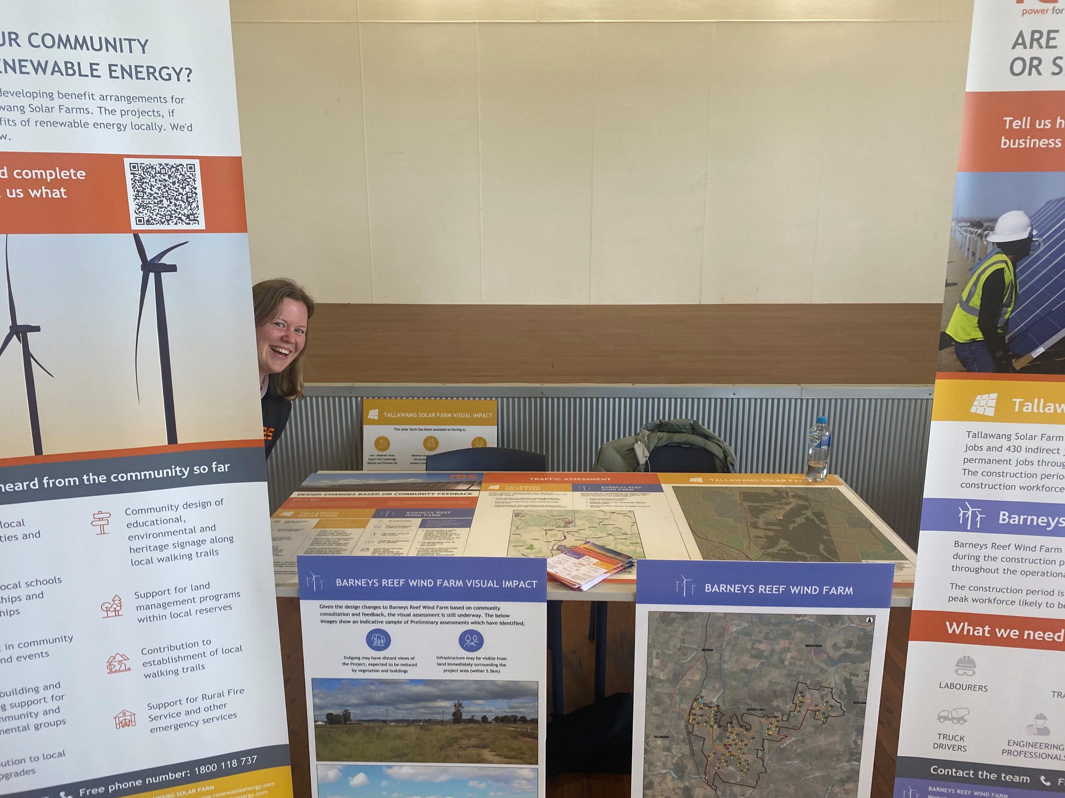
COMMUNITY CONSULTATION
Energy Co Information Sessions
Information sessions held at Dunedoo and Gulong in late September
Feedback sought from community on –
  Benefit sharing development
  Opportunities and barriers for local contractors
  Barneys Reef design changes
Updates provided on Tallawang SF upcoming submission

Slide 9
COMMUNITY CONSULTATION
Other/Ongoing Consultation
Meeting with Mid-Western Regional Council to discuss community benefit development (Sep)
Presentation and update provided to Mudgee District Environmental Group (Sept)
Engagement with project neighbours to describe identified visual impact and agree on mitigative measures (Oct-Nov)
Ongoing engagement with community groups and individuals to develop short term sponsorships and long-term partnerships for ongoing benefit sharing

Slide 10
COMMUNITY CONSULTATION
2022 Sponsorships
Community Bus - funding for 6 months – confirmed extended funding for further 6 months
Mudgee Rotary - partial funding for Louisa Lawson Statue
Gulgong Gossip - 'Kids Corner' sponsorship for 6 months
Art Unlimited – Photo Prize sponsor
Run for Resilience – Dunedoo race sponsor
Gulgong and Dunedoo Shows – show sponsor
Mudgee LALC – committed funds to property development**
Red Hill Environmental Education Centre – Eco Schools Program Funding – 12 months
Gulgong Netball Association – Debutante Ball Funding
Dunedoo Tunes on the Turf – Event Sponsor
Wellington Wiradjuri Aboriginal Corporation – Mapping Equipment and Training TBC

Slide 11
Long-term Benefit Sharing Development
RES working with various parties to understand community, government and industry expectations for community benefit sharing
Merit criteria has been developed by the regulator to encourage thoughtful, long term benefit arrangements from successful projects to communities
Regulator to propose separate regional benefit programs through the development and connection of successful projects to government owned REZ infrastructure
Feedback continues to be sought from the community to identify opportunities, ideas and to understand concerns about how benefit is to be provided from our proposed projects

Slide 12
DEVELOPMENT
Tallawang Solar Farm Update
DA to be registered shortly for public exhibition
Exhibition will commence after lodgment, for 28 days
https://pp.planningportal.nsw.gov.au/development-assessment/state-significant-infrastructure

Slide 13

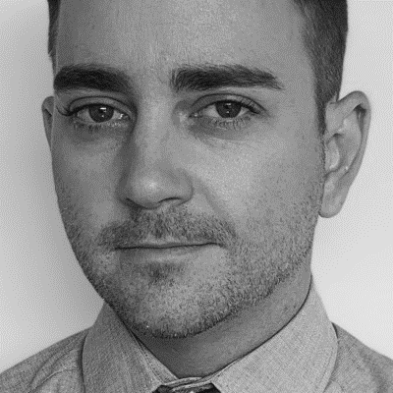


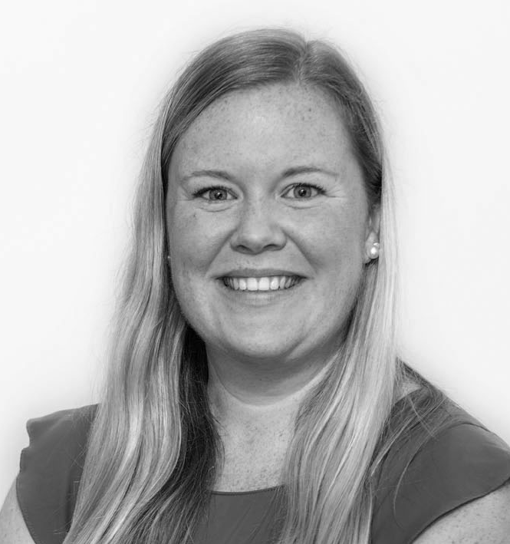
Get in touch
165 Walker Street
North Sydney
NSW 2060
Darren Chesterfield
Community Engagement Manager
+61 487 203 829
darren.chesterfield@res-group.com
Eleanor Cairns
Development Project Manager
+61 434 368 215
eleanor.cairns@res-group.com

