Slide 1
Barneys Reef Wind Farm
Community Consultative Committee meeting, January 2023

Slide 2
Agenda
Project Update
EIS Results
Community
Tallawang Solar Farm Update
Q & A

Slide 3
PROJECT UPDATE
Project Progress
Archaeology test pitting programme has been completed
Most EIS studies have been completed and draft reports received:
Aviation Assessment
EMI/EMF
Blade Throw
Noise
Hydrology
LVIA (report by mid-Feb)
Biodiversity (report by mid-Feb)
Archaeology (report by mid-Feb)
Remaining results and reports to be received within the next two weeks

Slide 4
AVIATION ASSESSMENT
Results
Based on the Project layout and overall WTG blade tip height limit of 280m, the blade tip elevation of the highest WTG will not exceed 851.7m and therefore:
Will not impact any nearby designated air routes
Is outside the clearance zones associated with aviation navigation aids and communication facilities
Downstream wake turbulence is unlikely to impact Merotherie Crossing ALA in the southern circuit area
Gulgong ALA remains clear of any wake turbulence effects
WTGs are not required to have aviation lighting
Next Steps
Aviation Projects to undertake consultation
Finalise report

Slide 5
EMI/EMF AND BLADE THROW ASSESSMENTS
Results
EMI related impacts are expected to be minimal, with the exception of possible impacts to terrestrial television broadcasting and meteorological radars.
Where possible interference does exist, the overall likelihood is low, and any impacts can be managed and mitigated once the Project is operational
EMF impacts to human health are low.
Blade throw assessment showed 4 of turbines in areas that were causing higher than usual risk to neighbouring properties. These turbines have been moved a small distance (up to 10m) to remove this risk.
Next Steps
Consultation with operators of point-to-multipoint links, emergency services, and wireless internet services
Finalise reports

Slide 6
NOISE AND VIBRATION ASSESSMENT
Results
Noise and Vibration Assessment has been undertaken in accordance with the Wind Energy Noise Bulletin.
Noise under worst case weather conditions (with mitigation applied), from the operation of the proposed turbines, is predicted to achieve the operational noise criteria required by the Noise Bulletin (35dB(A)) at all dwellings surrounding the Project Area
Noise associated with construction traffic and works would be temporary and subject to a Construction Environmental Management Plan
Vibration effects associated with construction are not predicted to occur at any surrounding dwellings
Next Steps
Finalise report
Undertake consultation with neighbours who may be impacted by construction noise

Slide 7
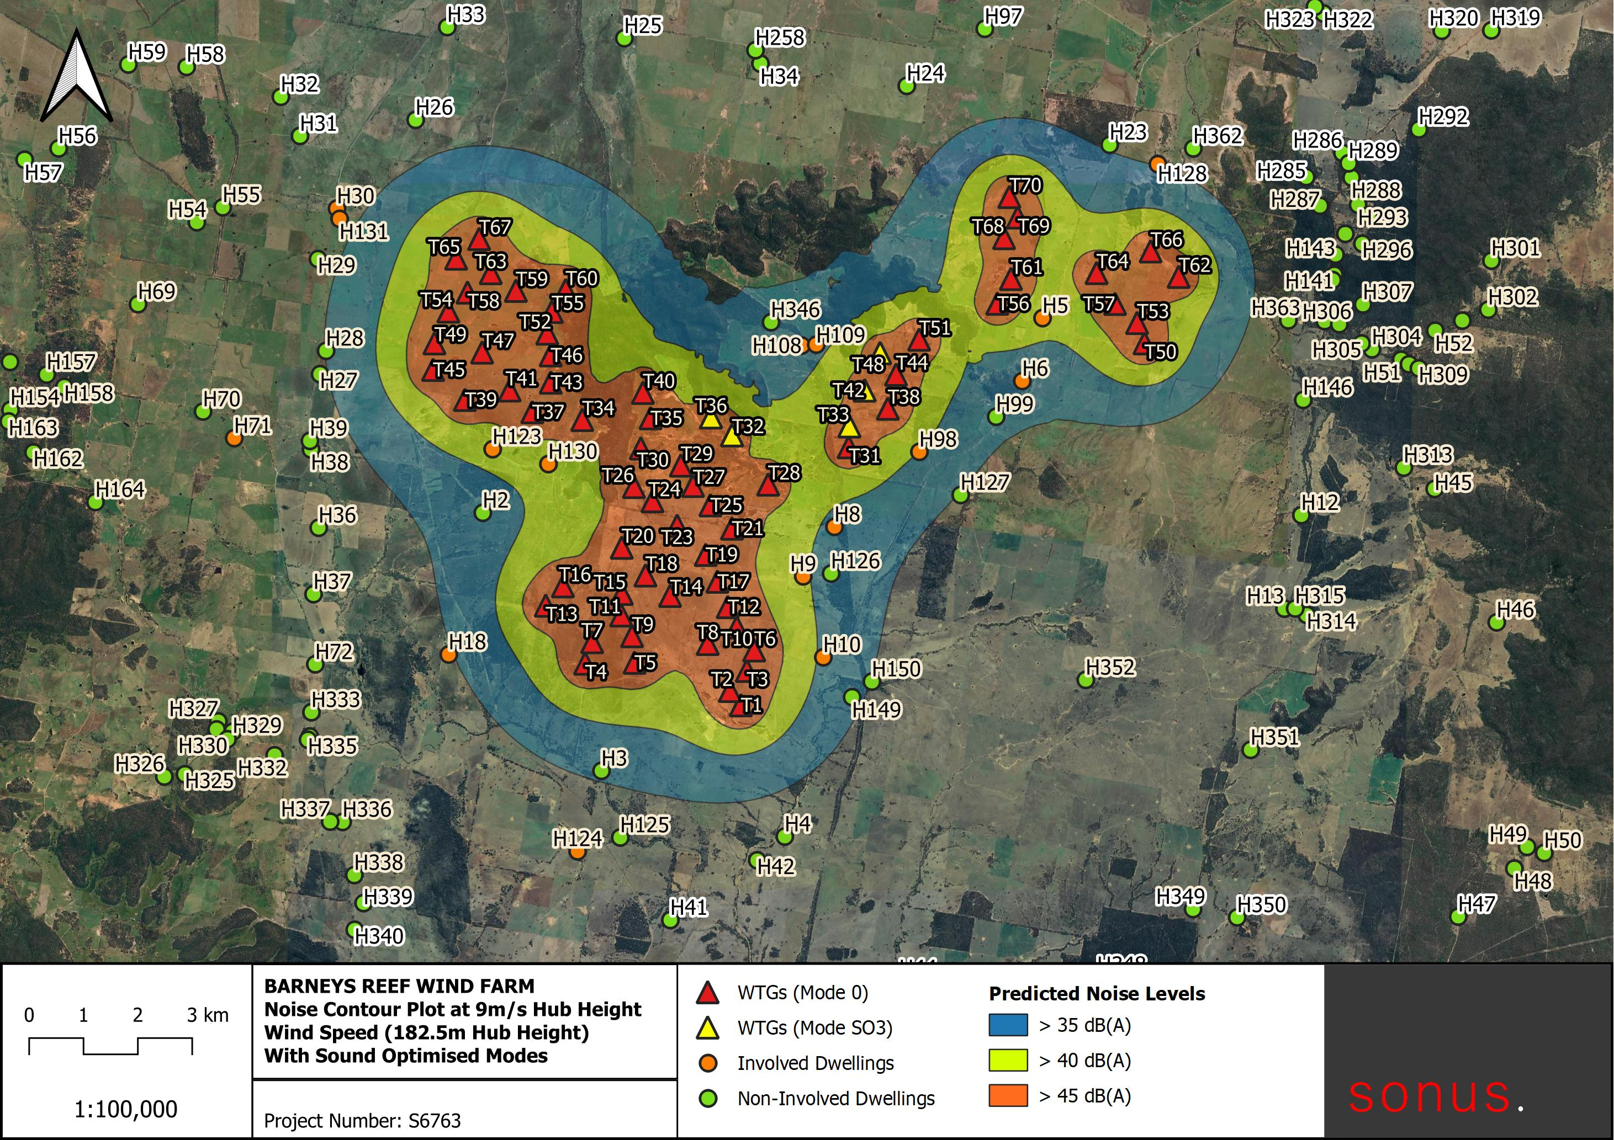
NOISE AND VIBRATION ASSESSMENT

Slide 8
LVIA
Results
The team recently completed another round of field surveys, ensuring that all dwellings were viewed.
Turbines will be visible from a number of public vantage points (e.g.
Neighbouring houses impacted visually by the turbines will either:
Have the option of mitigation implemented; or
Be consulted with to discuss the impacts and obtain agreement on the level of impact
Next Steps
Prepare the remainder of photomontages
Prepare report
Finalise consultation with impacted neighbours

Slide 9
HYDROLOGY ASSESSMENT
Results
Detailed flood assessment has been undertaken.
Shows that all proposed infrastructure would be located free from flooding up to and including the 0.2% (500 year) Annual Exceedance Probability (AEP) flood event.
Impacts to watercourses within the Project Area would be limited to crossings associated with the proposed access tracks.
Detailed erosion and sediment control measures would be developed during the detailed design phase, particularly in areas prone to erosion
Next Steps
Finalise report

Slide 10
BIODIVERSITY ASSESSMENT
Results
Biodiversity Development Assessment Report (BDAR) is being finalised, based on extensive field survey across the project area
Construction would result in the removal of some vegetation and associated fauna habitat
The following has been identified across the field surveys:
89 bird species and 7 microbat species (of which 13 are threatened)
1 threatened ecological community
0 threatened flora species
The project has been designed to minimise impact to the identified species
Next Steps
Finalise report

Slide 11
ARCHAEOLOGY ASSESSMENT
Results
Six-week test excavation program completed in late 2022. Focus was to test the potential for subsurface deposit and to sample the various landscape features for potential sub-surface archaeological deposits
Approx. 1500 potential artefacts were recovered, which are now being analysed and assessed
Key findings:
29 isolated finds
31 artefact scatters
1 Aboriginal rock shelter
1 European grave site
Next Steps
Finalise analysis
Prepare report
Send report for review by the RAPs
Finalise report ahead of EIS submission

Slide 12
PROJECT UPDATE
Project Timeline
DA submission expected end of Q1 2023.
No change expected to the timing of construction for the project, this will still be aligned with the energisation of the CWO REZ
Construction expected to begin Q3 2024

Slide 13
DEVELOPMENT
Tallawang Solar Farm Update
Project completed its public exhibition phase at the end of November 2022
Project received 54 objections, including from Mid-Western and Warrumbungle Councils
As a result, the project has been referred to the IPC (Independent Planning Commission)
Tallawang is currently working through their Response to Submissions, expected to submit at the end of March 2023.
https://pp.planningportal.nsw.gov.au/development-assessment/state-significant-infrastructure

Slide 14
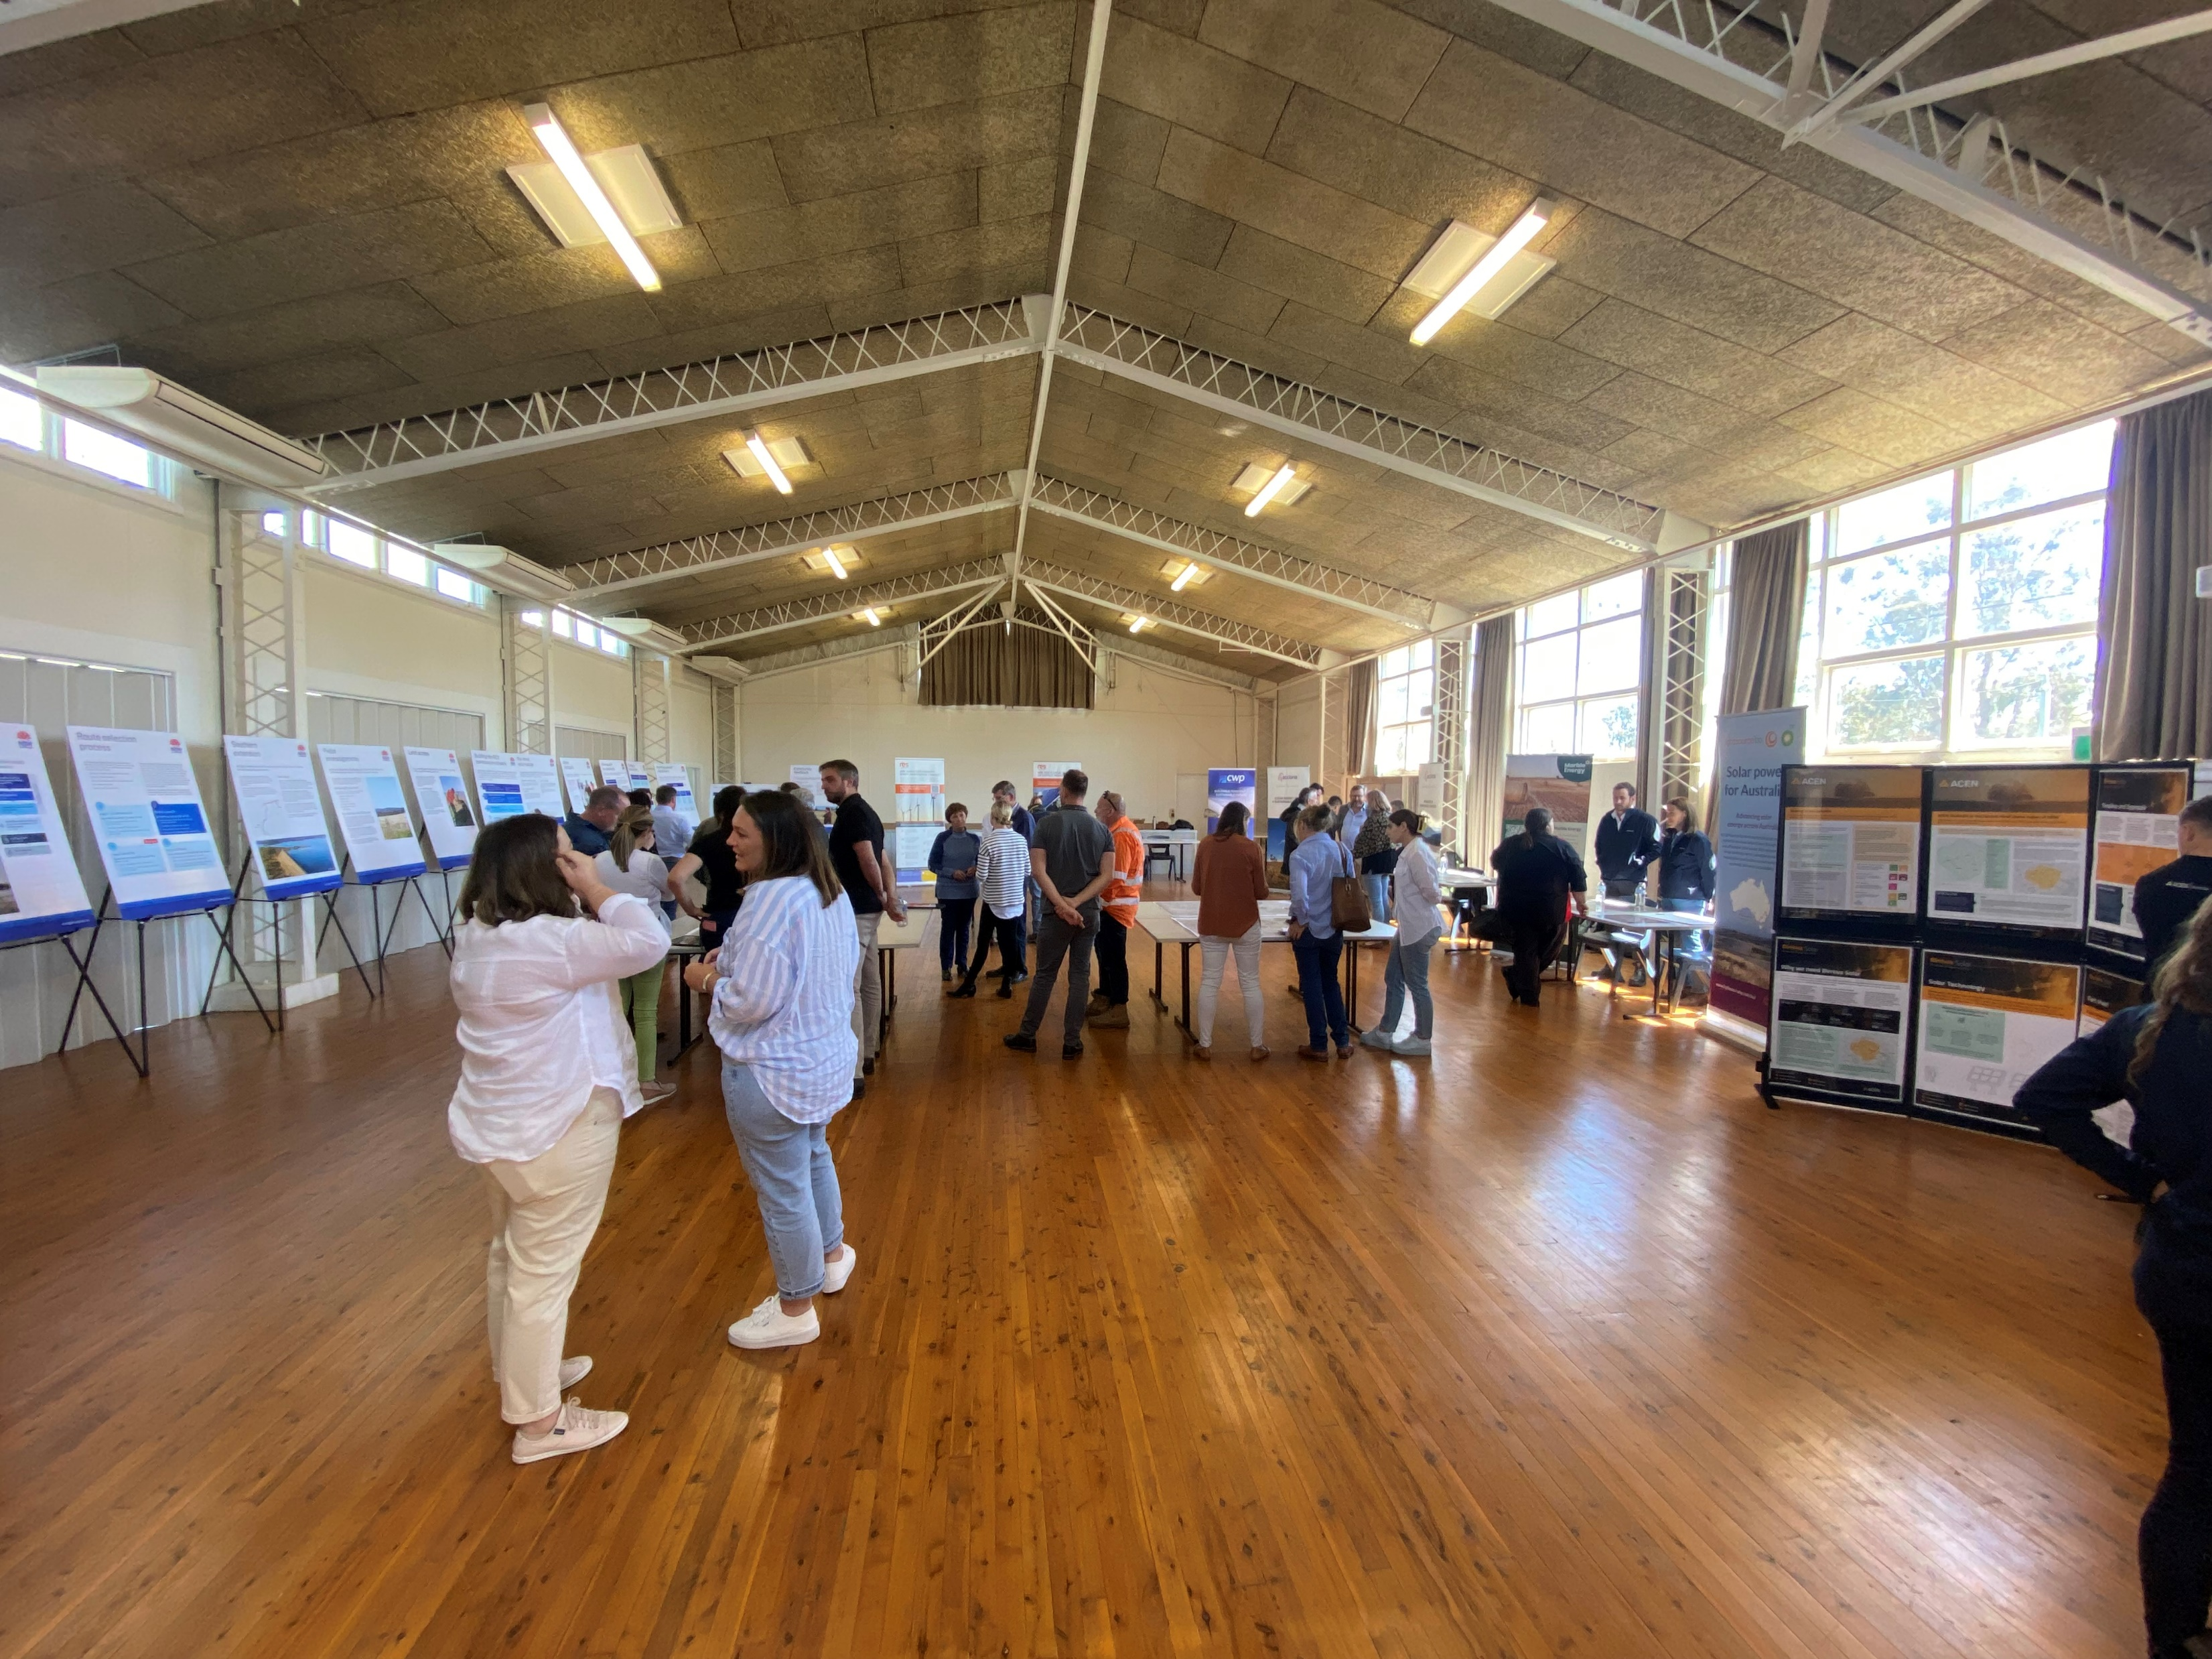
COMMUNITY CONSULTATION
Community Information Sessions to held at
Dunedoo Show (11TH Feb)
Memorial Hall (15th Feb)
Gulgong Show (18th Feb)
Feedback continues to be sought on the final design of the Barneys Reef Wind Farm
Discussions ongoing with visually impacted neighbours
Response to submissions for Tallawang Solar Farm
Benefit Sharing Programs finalised April 2023

Slide 15
COMMUNITY CONSULTATION
Other/Ongoing Consultation
Meeting with Mid-Western Regional Council to propose Benefit Sharing Programs – proposed to formalise under a voluntary planning agreement
Neighbour Shared Benefit Program to open up for registrations Q1
Discussions ongoing with Native Title Claimants
Ongoing engagement with community groups and individuals to develop short term sponsorships and long-term partnerships for ongoing benefit sharing

Slide 16
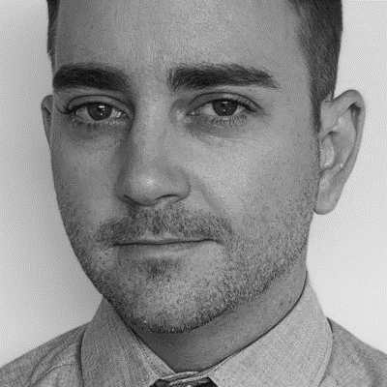
Get in touch
165 Walker Street
North Sydney
NSW 2060
Darren Chesterfield
Community Engagement Manager
+61 487 203 829
darren.chesterfield@res-group.com
Eleanor Cairns
Development Project Manager
+61 434 368 215
eleanor.cairns@res-group.com

