Slide 1
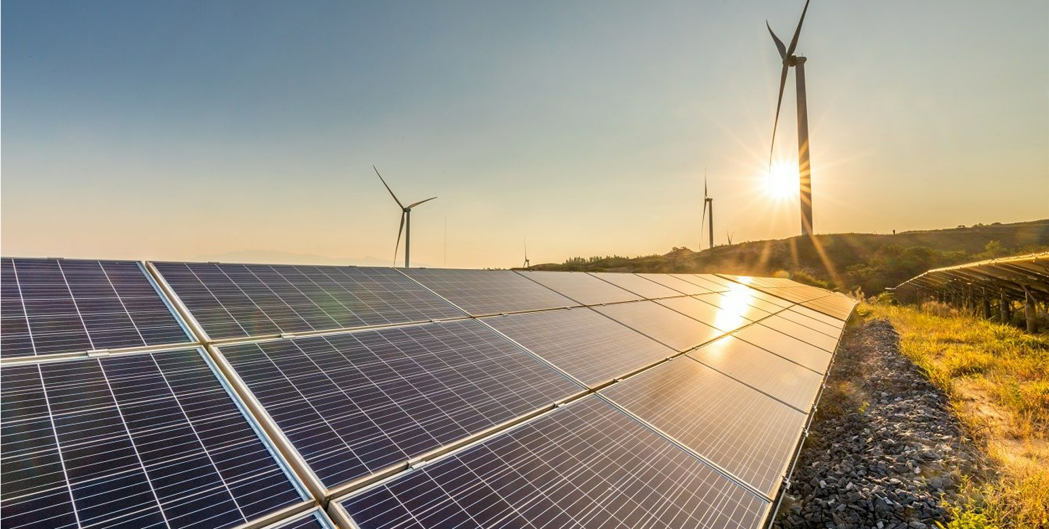
Barneys Reef Wind Farm
January 2022 Community Consultative Committee

Slide 2
Notes:
EC

Slide 3
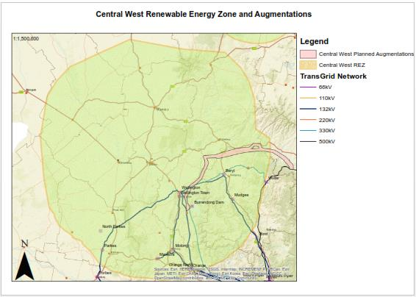
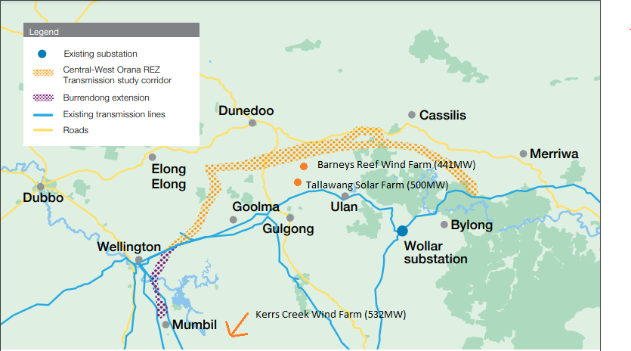
Why Here?
Project located with in the Central West Orana REZ - one of several zones in NSW identified for Renewable Energy investment and driven by Government to replace retiring thermal generators
New 500KV grid infrastructure proposed connecting into the backbone between Liddell and Wollar
Site selected due to good wind and solar resources and compatible land use zoning
Good road access, with transport routes selected utilising main access routes
Availability of land of a suitable scale for a viable commercial scale wind and solar farm project
Notes:
EC

Slide 4
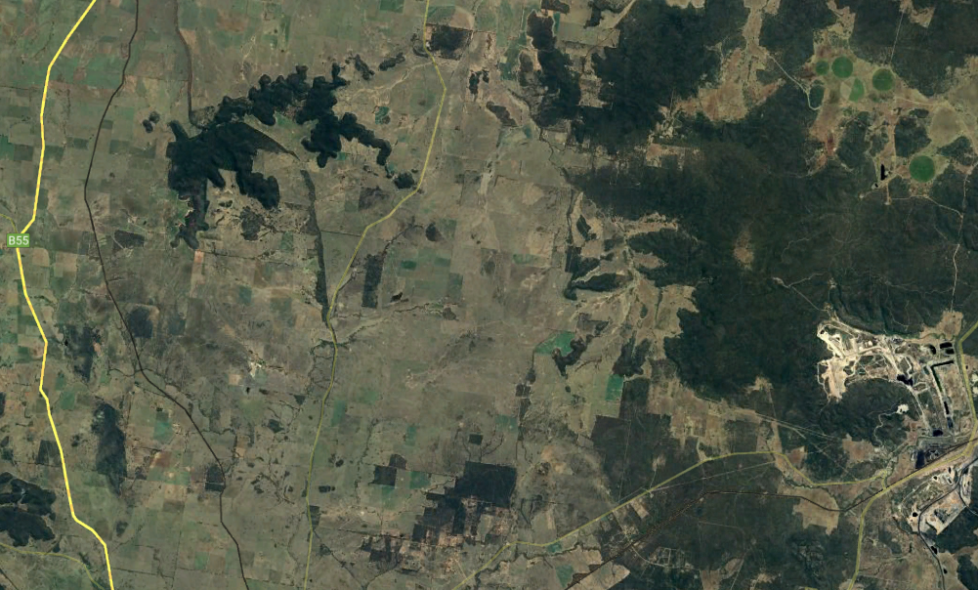
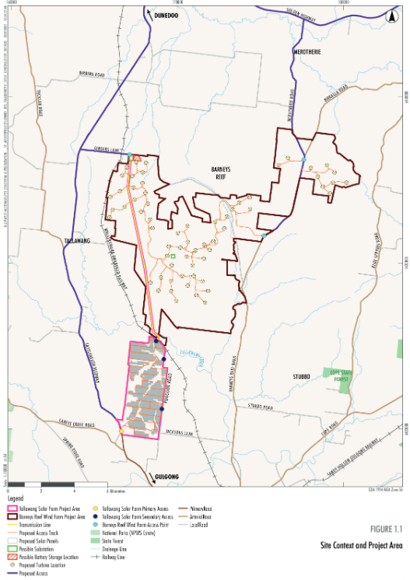
Project Location
The proposed Barneys Reef Wind Farm is located approximately 12km north of Gulgong.
The project is wholly within Mid-Western Regional Council and Central-West Orana Renewable Energy Zone.
Directly adjacent to RES’ Tallawang Solar Farm (also in a similar stage of development).
Notes:
EC

Slide 5
PROJECT PROGRESS
Project Summary
Barneys Reef Wind Farm
Capacity | 441MW (circa 63 turbines- subject to layout design)
Battery Storage | 441 MW /1,764MWh
SEARs Received | Q3 2021
DA and Environmental Impact Statement submission | Q1 2022
Indicative Construction | Q4 2023
Site | 7,548 ha
Four seasons of ecology surveys complete
Preliminary Landscape and Visual and Noise Assessments Complete and full assessments underway
SEARs received September 2021
Social Impact Assessment underway
Community consultation underway
Connection into proposed 330kV network in the CW Orana
Preliminary grid modelling completed
One year of wind data collected
Additional wind monitoring equipment installed late 2021
Turbine layout optimisation underway to increase turbine utilisation rate and power output
Detailed EIS assessments underway, expected lodgement of EIS and DA in March 2022
LAYOUT
Project Area excludes vegetation associated with Barneys Reef formation and avoids disturbance to Registered Aboriginal sites
Internal access tracks designed to avoid vegetation removal where possible
Appropriate access points to the Project Area located to restrict level of road works required
Notes:
EC

Slide 6
Indicative Project Timeline
Complete EIS studies and finalise reports Jan-Feb 2022
Development Application and Environmental Impact Statement Lodgement March 2022
Neighbour Shared Benefit Scheme finalised June – July 2022
Construction Commencement Dec 2023/Jan 2024
Commercial Operations April 2026
Repowering or Decommissioning April 2056
Notes:
EC

Slide 7
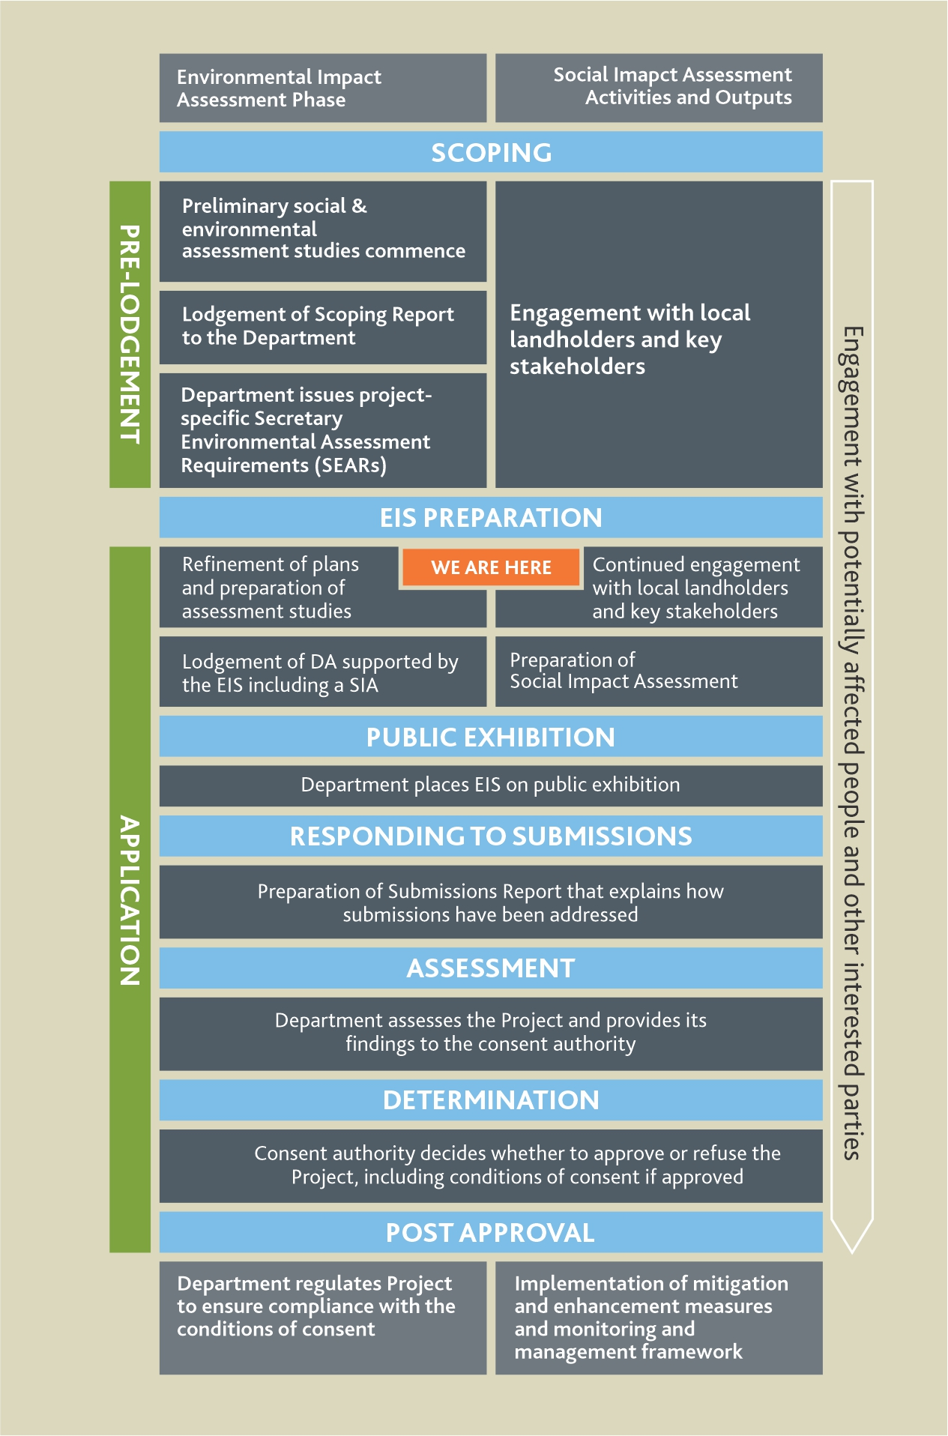
Planning and Development Process
Barneys Reef Wind Farm will trigger the SSD planning process in NSW
Social and environmental assessment studies are underway, including:
Noise
Visual
Biodiversity
Aboriginal cultural heritage, incl Historic heritage
Water
Traffic
Social
Economic
Soils
Land Use Conflict
Hazard and Risk (including Aviation Safety, Electromagnetic Interference, Electromagnetic Fields, Blade Throw and Blade Glint, Bushfire Threat and Preliminary Hazard Analysis for the Battery Store)
Cumulative effects
Notes:
EC

Slide 8
Project Layout
Has been designed with the following in mind:
All infrastructure avoids ‘Barneys Reef’ formation
Avoids high risk ecological area and minimises impact in moderate risk ecological areas
Has avoided all Aboriginal artefacts identified from desktop study (field work currently underway, infrastructure to be moved if required from this)
Turbine setback of 2km from all non-involved residences
High voltage powerlines designed to minimise visual impact to near neighbours
Turbines will continue to be microsited as more information becomes available
Preliminary studies conducted on this layout. Layout changes and optimisation are underway to complete the EIS studies.
Notes:
EC

Slide 9
Barneys Reef Wind Farm – Access
Preliminary Findings
Proposed access to Project Area from Merotherie Road (via Golden Highway) and/or Gingers Lane (via Castlereagh Highway)​
Upgrades to local roads and intersections will be required – subject to further detailed assessment and design​
Potential traffic impacts associated with the Project will be subject to detailed assessment
Delivery of turbine components via Newcastle Port, New England Highway and Golden Highway – detailed route analysis will be undertaken to determine any works required along the delivery route and at access point to Project Area
Notes:
EC

Slide 10
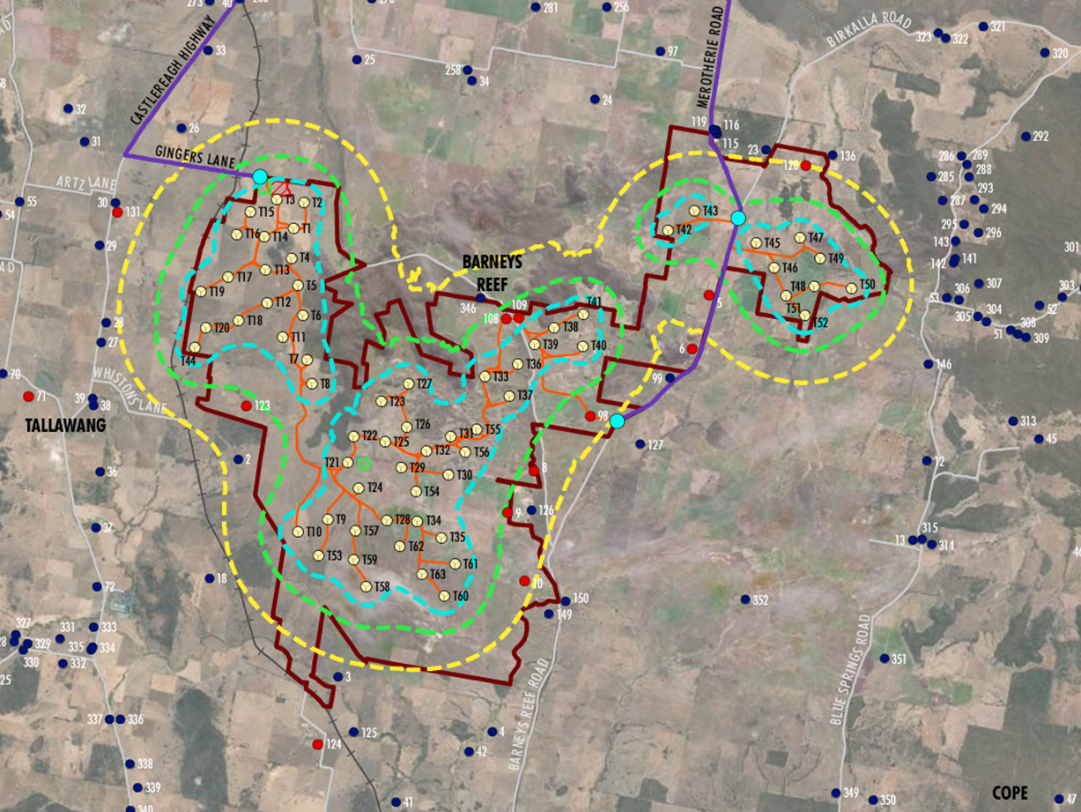
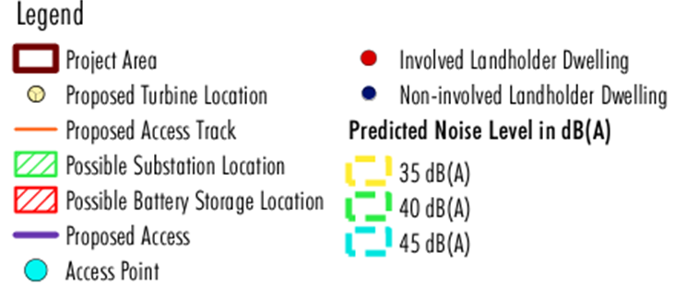
Barneys Reef Wind Farm – Noise
Preliminary Findings
Preliminary noise modelling indicates baseline criterion of 35 dB(A) can be achieved at most non-involved dwellings without modification to the turbine layout or the development of a mitigation strategy for non-involved dwellings
6 week background noise monitoring program currently underway to inform detailed modelling
Final layout currently under review and will seek to minimise noise
Notes:
EC

Slide 11
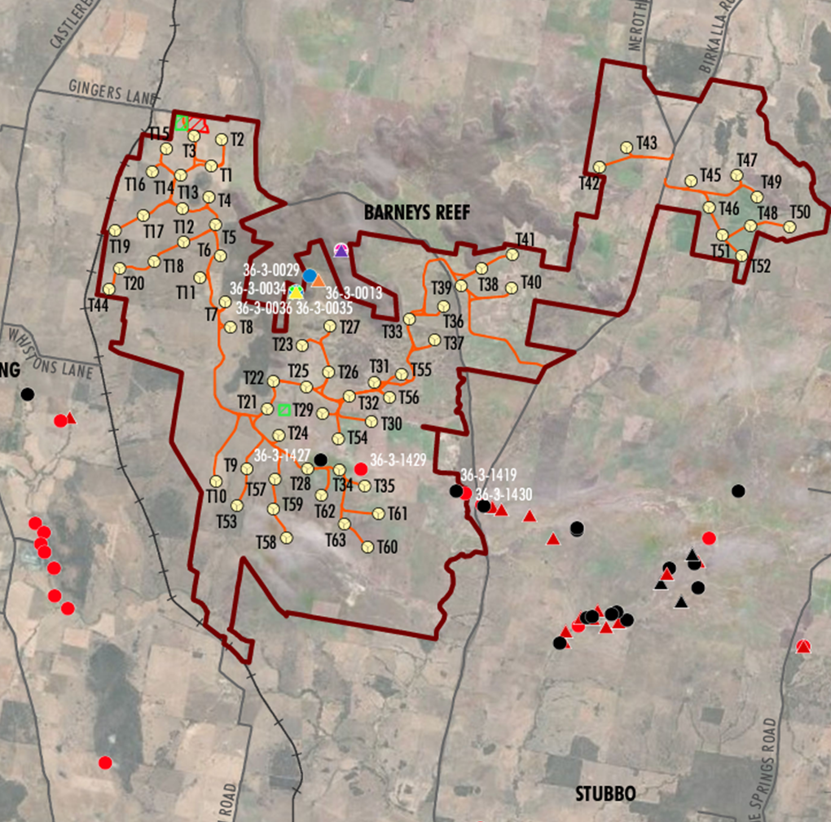
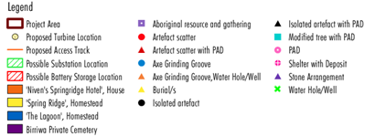
Barneys Reef Wind Farm – Heritage
Preliminary Findings
12 registered sites within Project Area (burial site, rock shelters, axe grinding groove, stone arrangements, waterhole/well and artefact scatter)​
One active Native Title claim registered
No Commonwealth or world listed heritage in close proximity to the Project Area​
No State Heritage listed items or local heritage sites within vicinity of Project Area
Detailed Aboriginal Cultural Heritage Assessment to be undertaken in consultation with Registered Aboriginal Parties
Notes:
EC

Slide 12
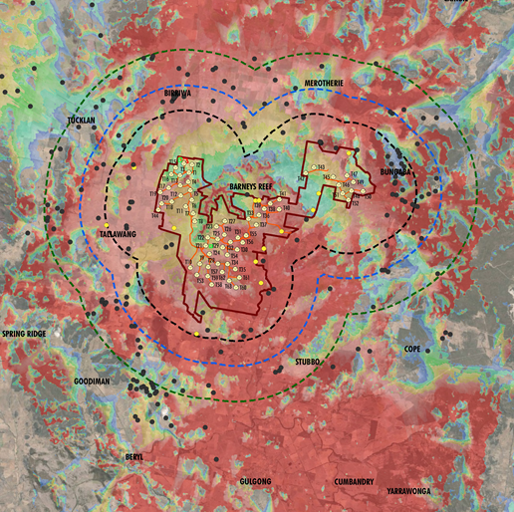
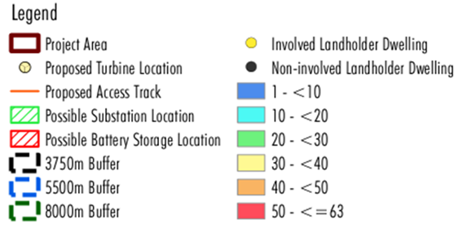
Barneys Reef Wind Farm – Visual
Preliminary Findings
Zone of Visual Influence (ZVI) desktop assessment based on topography only
ZVI indicates the project would theoretically be visible from a large percentage of land immediately surrounding the Project Area
Town of Gulgong and surrounds will have the potential to view the Project in its entirety (vegetation and buildings expected to reduce the visibility)
Views to the Project Area will be screened by topography from the town of Dunedoo
Notes:
EC

Slide 13
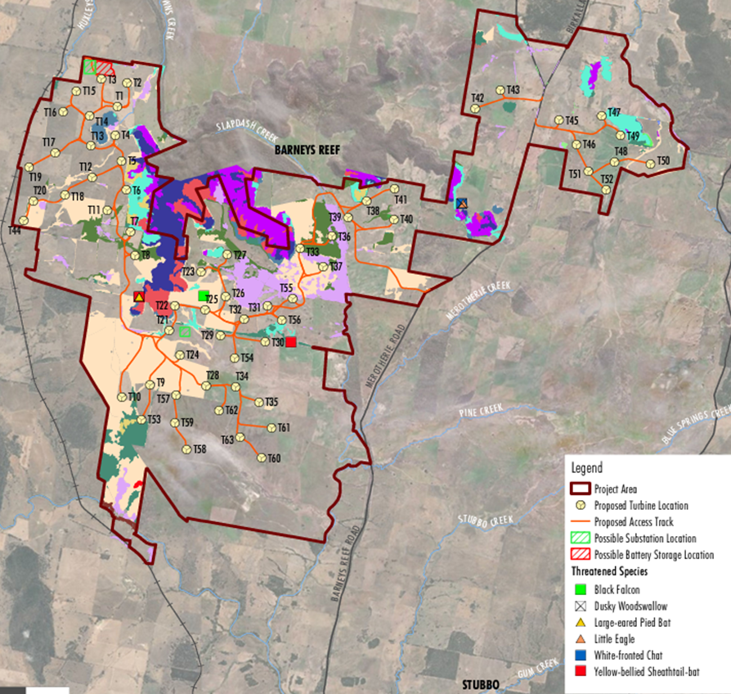
Barneys Reef Wind Farm – Biodiversity
Assessment So Far
Seasonal field survey completed – Spring 2020, Summer 2020/21, Autumn 2021, Winter 2021, Spring 2021 and Summer 2021/2022
Survey has included targeted species, threatened flora, vegetation integrity plots and Bird and Bat Utilisation Surveys
Approximately 460 ha of Threatened Ecological Communities within the Project Area with the balance being non-native
Potential habitat for large-eared pied bat (threatened species) within Barneys Reef formation
Further assessment and mapping to be undertaken as part of the preparation of the Biodiversity Development Assessment Report
Notes:
EC

Slide 14
Shared Benefit Scheme
RES has a strong track record of responsible development and is committed to supporting the communities where it constructs and operates renewable projects
A community fund is being developed for both projects to support social, educational, environmental and other initiatives in the local communities
We are currently exploring options for the structure for the fund and welcome feedback from the community on how the fund should be set up and administered as part of the SIA
A separate benefit scheme is also being considered to ensure that immediate, adjacent and directly impacted members of the community share in the success of both projects
As discussions with council and the local community progress, updates on the structure of community funds will be shared with interested parties
Benefit
Service Providers
Community and Environmental Groups
Sharing
Host Landholders
Adjacent Landholders
Proximal landholders
Wider Community
Notes:
DC

Slide 15
Lookback – Community Engagement (2021)
Time | Method | Stakeholders | Purpose
February – March | face-to-face meetings, email, phone, website updates, video conference | Landholders, Neighbours, Council | Project introductions – confirm project size - understand community views
April - May | Video conferences, phone, email | Neighbours, Council | Project introductions – seek early feedback
June-July | Video conference, phone, email, letter, website update | Neighbours, Council, Community Organisations, Neighbours | Project introductions - gather feedback
August- September | Video conference, community information session, phone, email, letter, website update | Broader Community, Neighbours, Community Organisations, Service Providers | Gather feedback
October - November | Website update, face-to-face meeting, letter, phone, email, letter | Neighbours, Community Organisations | Gather feedback
December – January | Website update, face-to-face meeting, letter, phone, email, letter, consultative committee | Neighbours, Community Organisations | Gather feedback, communicate project changes and report on feedback received
February - March | To be determined | Broader Community, Neighbours, Community Organisations, Council | Communicate project changes and feedback received – provide ongoing updates
April - May | To be determined | Broader Community, Neighbours, Community Organisations, Council | Communicate project changes and feedback received – provide ongoing updates post-submission
June - July | To be determined | Broader Community, Neighbours, Community Organisations, Council | Provide ongoing updates post-submission
Notes:
DC

Slide 16
What We Have Heard So Far
Notes:
DC

Slide 17
Planned Community Information Sessions - 2022
In-Person
Dunedoo Show – Saturday February 12th 9am – 5pm
Gulgong Show – Saturday February 19th, 9am – 5pm
Online
Zoom information session planned for 23 February
Purpose:
provide information on assessment results
update on RES responses to community feedback
obtain feedback on progressed project design
receive and register interest from local suppliers
Notes:
DC

Slide 18
Thank you!
Project Contacts
Darren Chesterfield, Community Engagement Manager
1800 118 737
info@tallawang-renewableenergy.com
info@barneysreef-renewableenergy.com
Eleanor Cairns, Development Project Manager
0434 368 215
eleanor.cairns@res-group.com
Notes:
DC

